Slide 1

PROJECT Car Rental
Online Car Rental
by Domenic Palucci and Yaoheng Mo

Slide 2


The story …. Dilemna
Jerry

Slide 3

The Quest…

Slide 4

The site…discovered

Slide 5

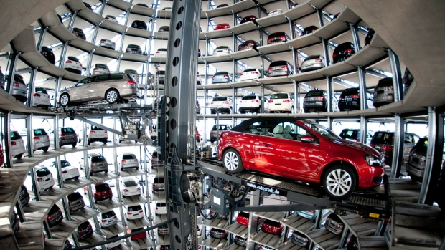


The process…

Slide 6
Site Structure
Main Content.
User Interface – register and login.
Ecommerce – Reserve / pay for the product or Service.
Admin section to administer database.

Slide 7

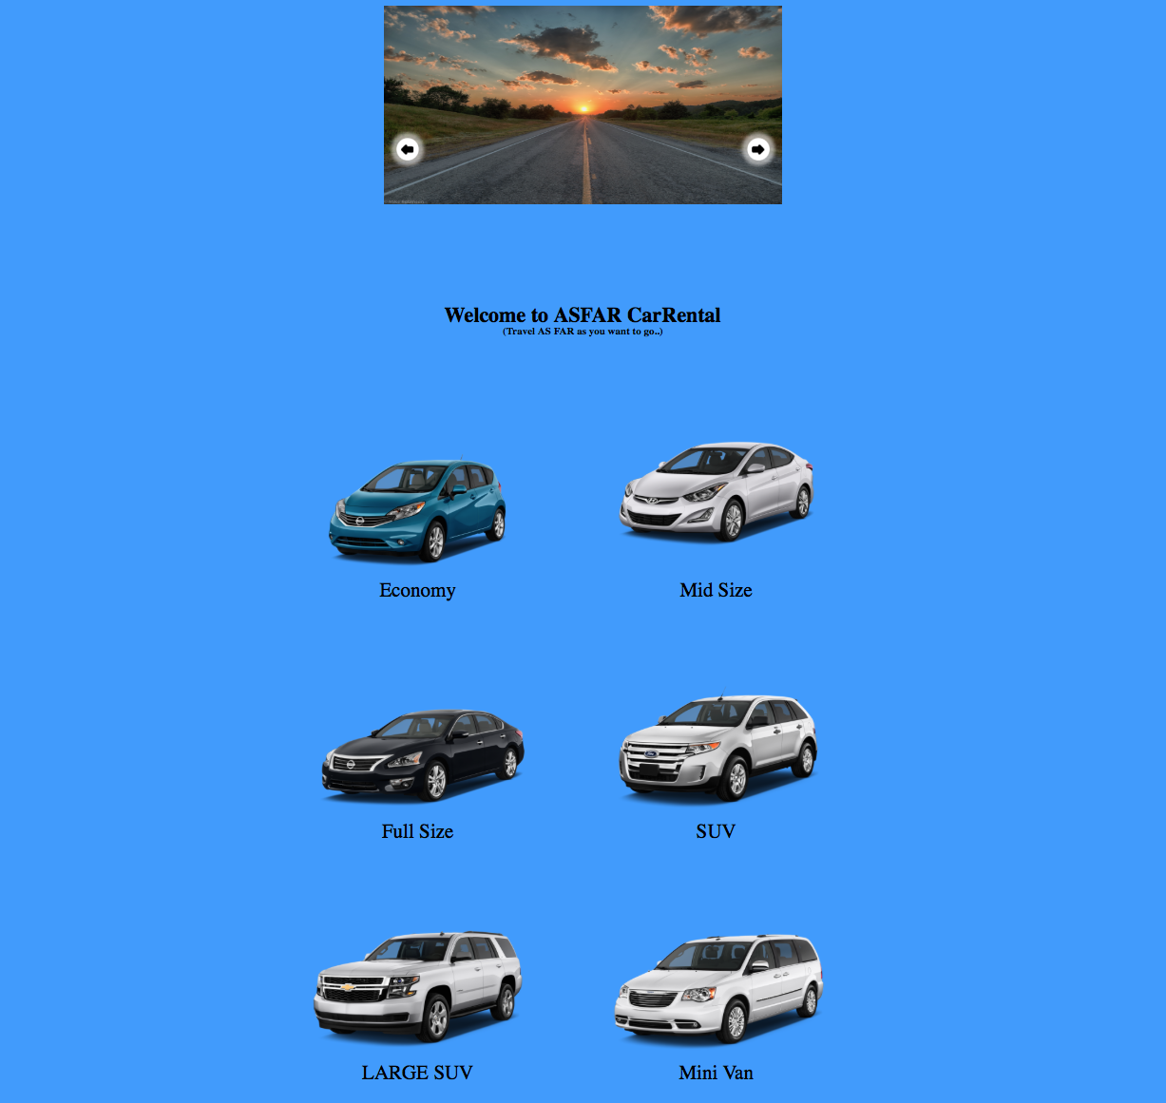
home Page
Main Categories
User Interface – register and login.

Slide 8
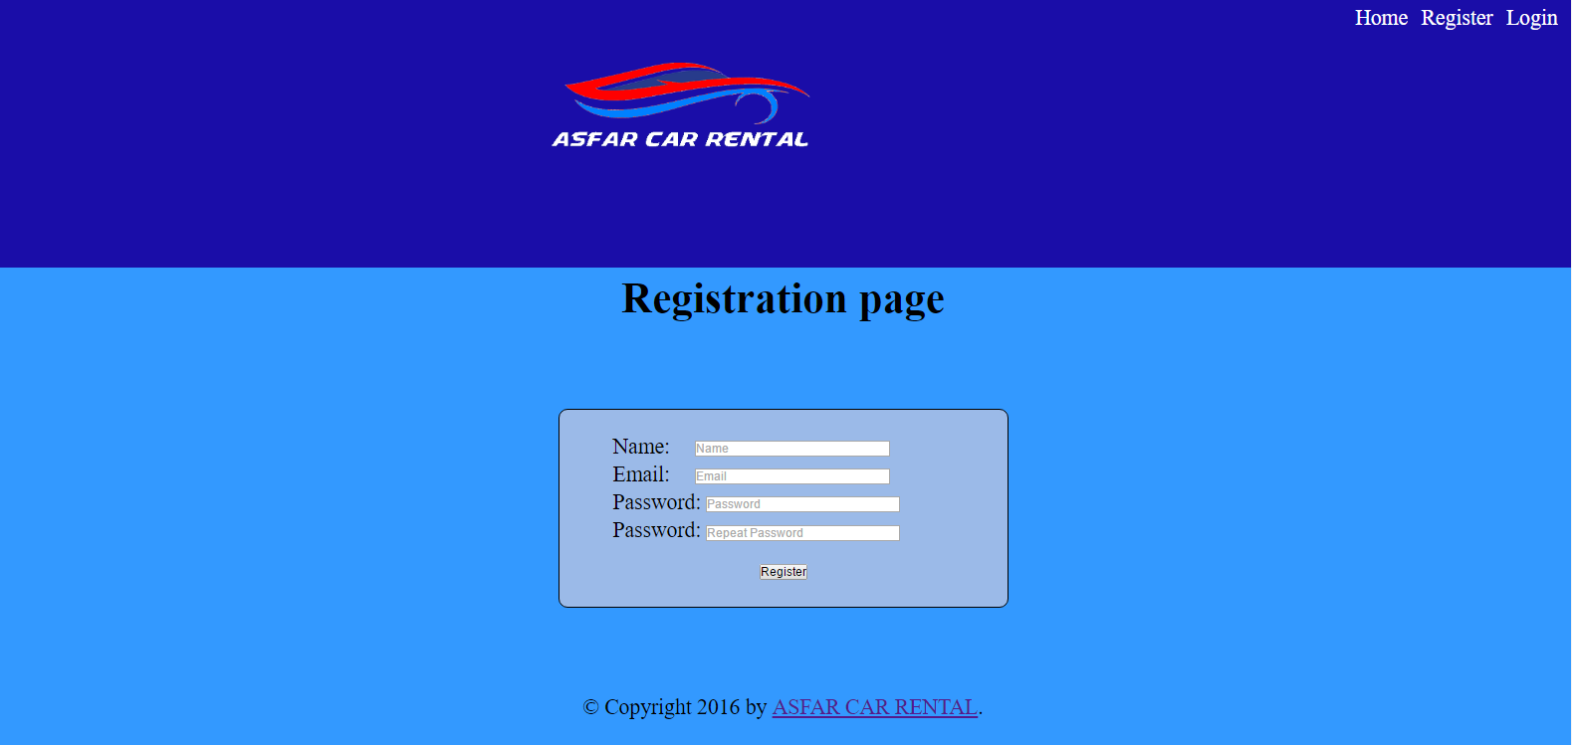
registration Page
All basic validity checks on email
Validity checks on user name and password.
Password using Blowfish encryption

Slide 9
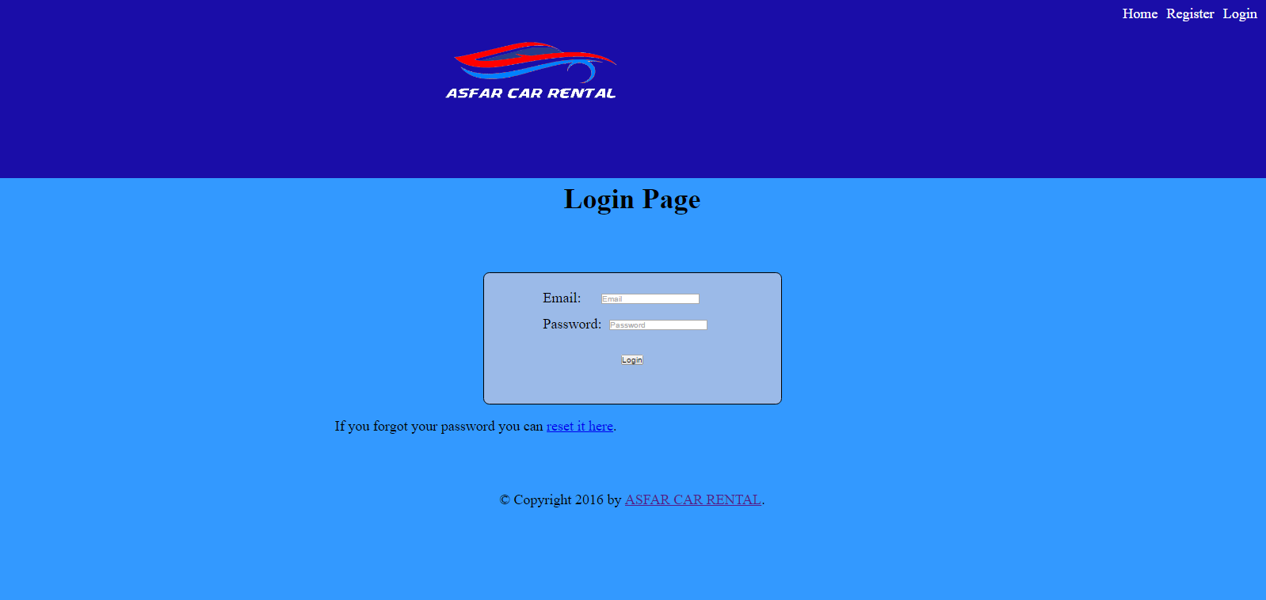
login Page
All basic validity checks on login and passwords.

Slide 10
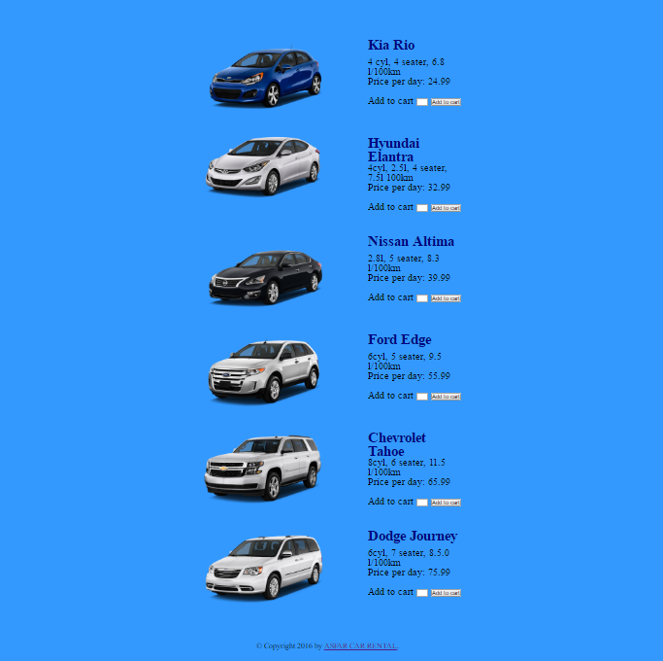
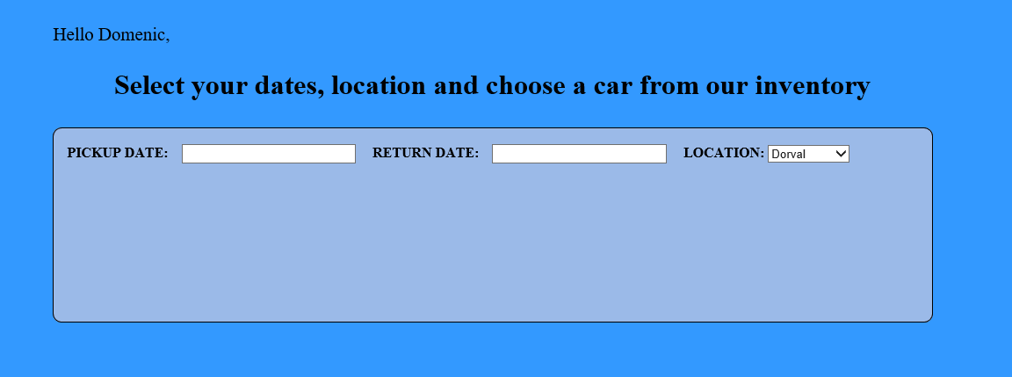
reservation Page
All basic categories of vehicles listed.
Brief Description of the vehicle and it’s capacities.
Add to Cart feature.

Slide 11
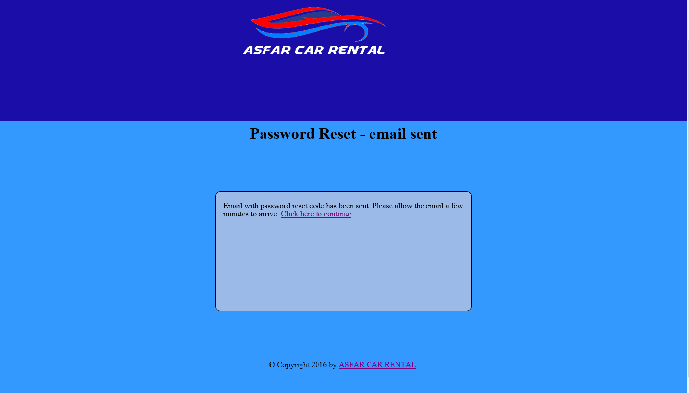
Password reset

Slide 12
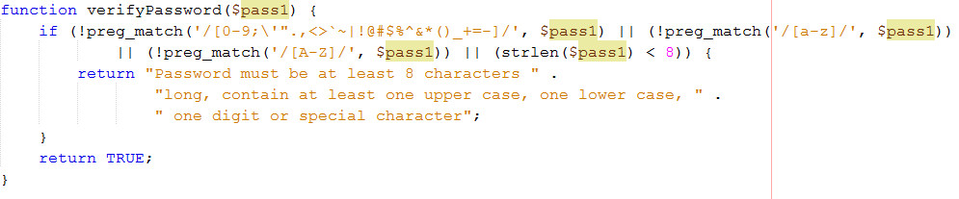
Password Validity check

Slide 13
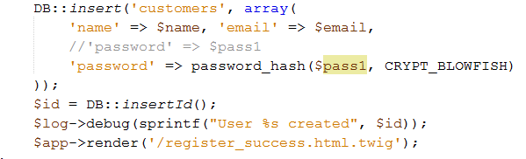
New Password reset in database

Slide 14
Challenging tasks
Database couldn’t find tables.
Forgot some missing code in the index file.
Password Recovery – could not insert new pwd in database, even though I received a successful password reset message.
Had to rework some HTML and CSS code.
Database issues – broken foreign keys.

Slide 15
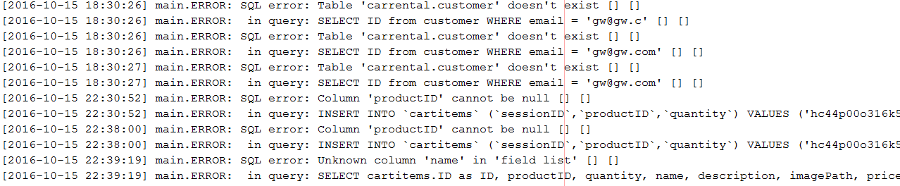
Log files

Slide 16
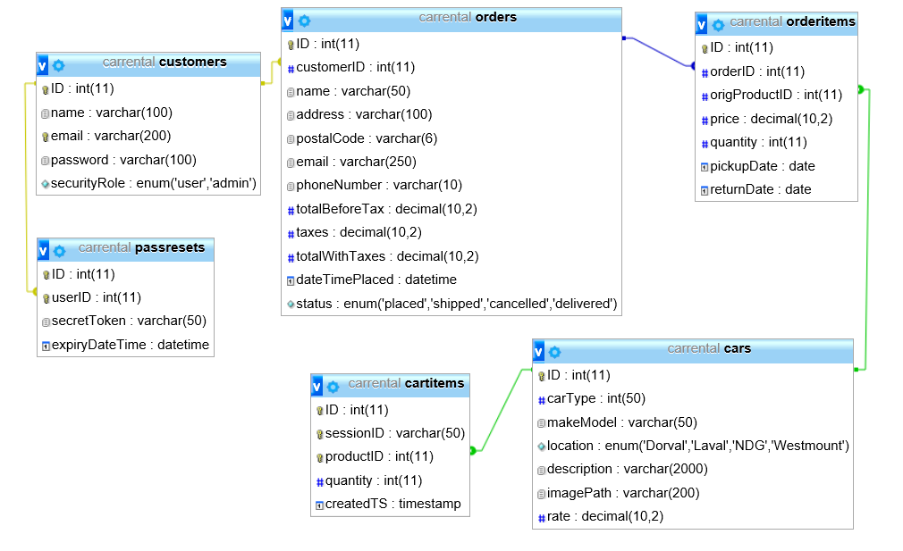
Database design

Slide 17
future enhancements
Improve the website look and better navigation.
Improve the Order process (more accurate and better look.
Implement my remaining features (Facebook login and Google Map API.
Broaden the categories and options.

Slide 18
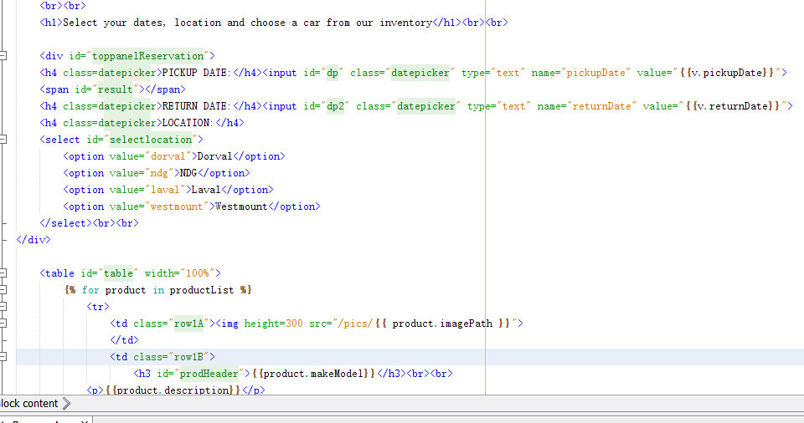
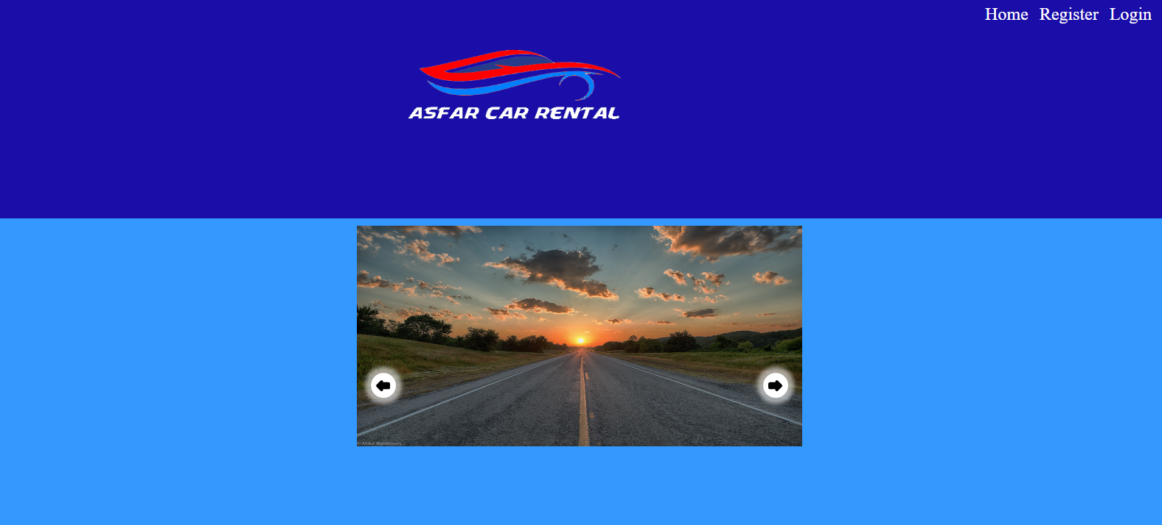
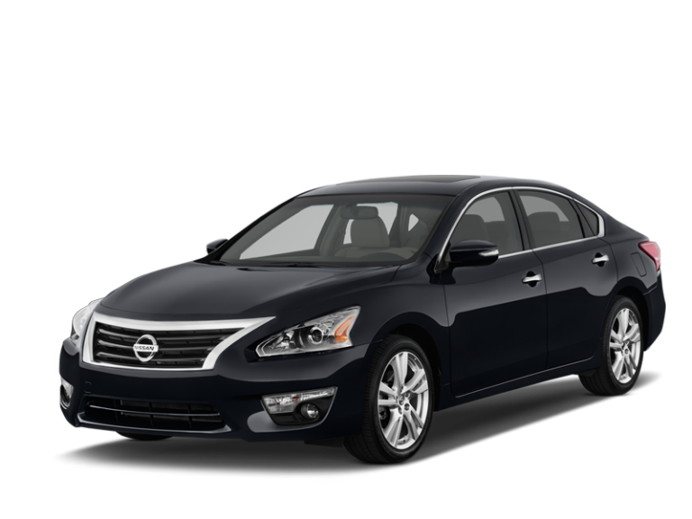


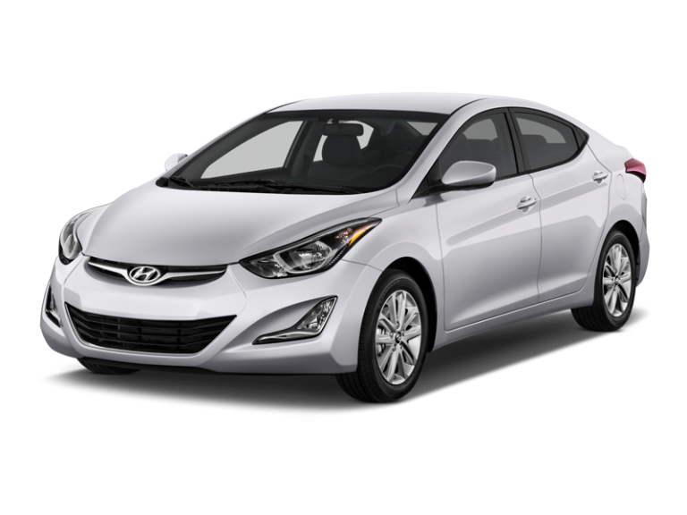
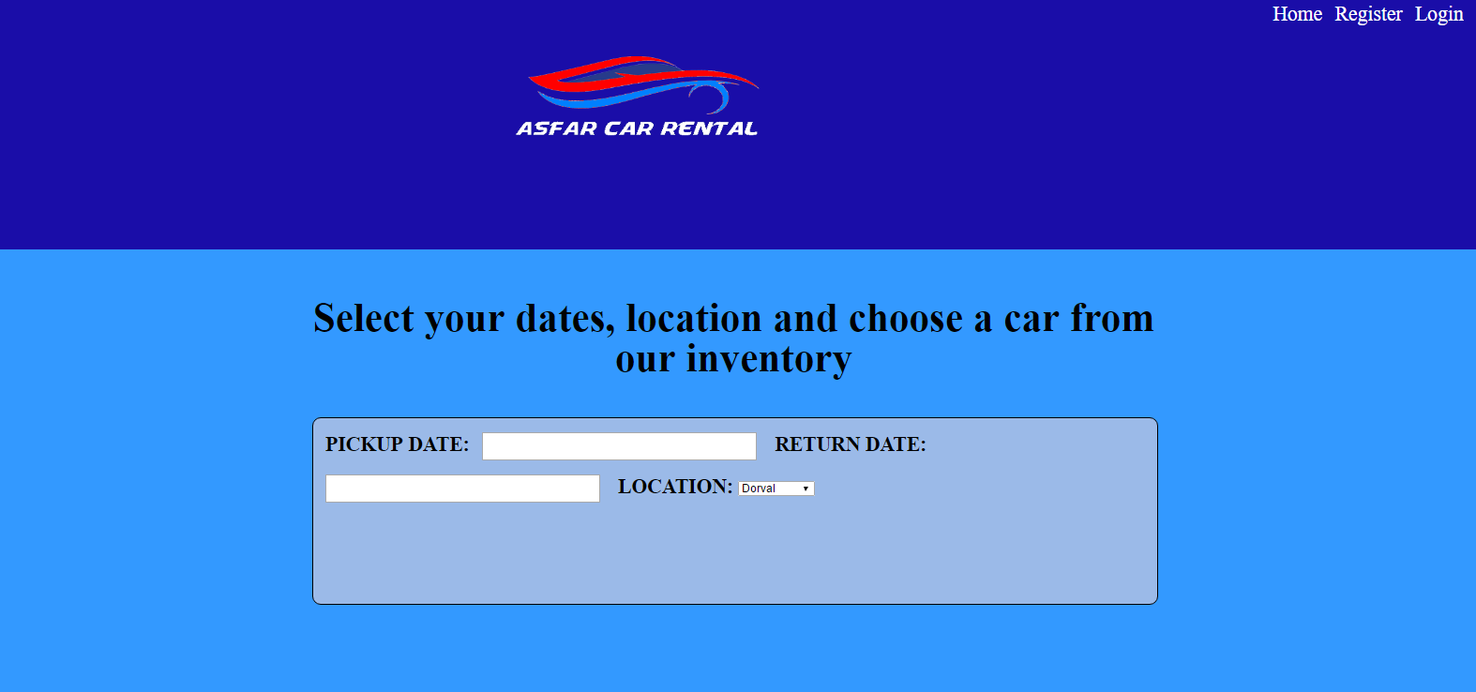
summary

Slide 19



The End …. Now sleep!

